Slide 1
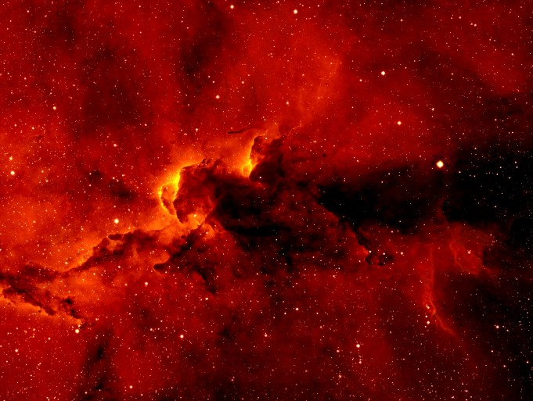
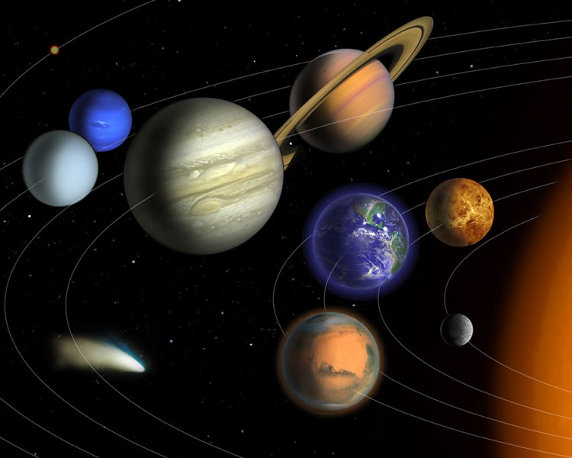

Origins of the Solar System and the Astronomer’s Periodic Table
How do solar systems form?

Slide 2
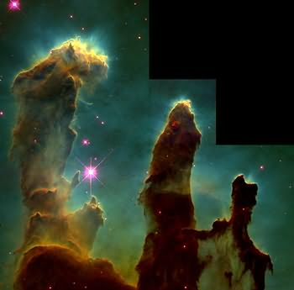
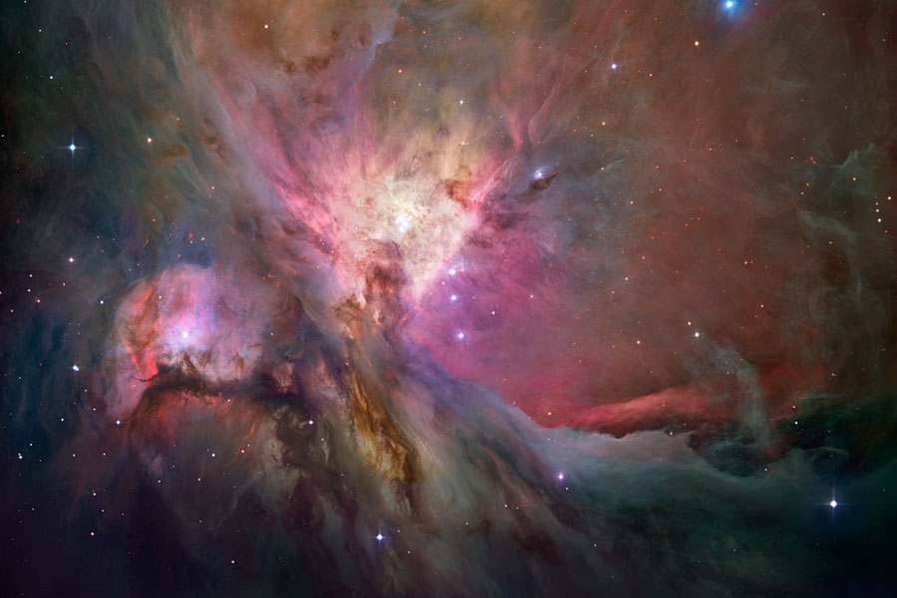
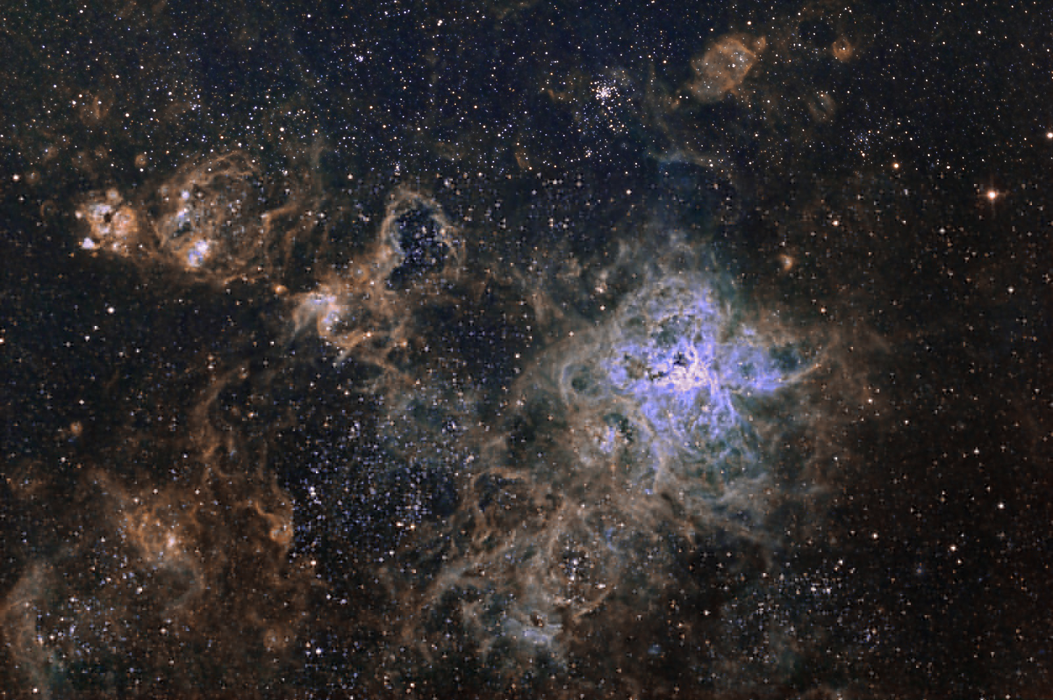
Stellar Nurseries
A
B
C
Notes:
About these Images
These are several images of nebulae, interstellar gas clouds, taken by the Hubble Space Telescope. A nebula provides the materials and events that lead to star formation and in some cases the formation of planets around stars.
To Notice
These images show massive clouds of gas and dust.
The bright spots in the clouds represent stars
Portions of these nebulae collapse to form stars and in some cases planets form around the stars.
Image A
Object: Gas Pillars in the Eagle Nebula
Source of Image: Hubblesite.org
Edited Excerpt from Caption Released with Image
These eerie, dark pillar-like structures are actually columns of cool interstellar hydrogen gas and dust that are also incubators for new stars. The pillars protrude from the interior wall of a dark molecular cloud like stalagmites from the floor of a cavern. They are part of the "Eagle Nebula" (also called M16 — the 16th object in Charles Messier's 18th century catalog of "fuzzy" objects that aren't comets), a nearby star-forming region 6,500 light-years away in the constellation Serpens.
Image B
Source of Image: Astronomy Picture of the Day
Edited Excerpt from the Caption Released with Image
The Orion Nebula, also known as M42, the nebula's glowing gas surrounds hot young stars at the edge of an immense interstellar molecular cloud only 1,500 light-years away. The Orion Nebula offers one of the best opportunities to study how stars are born partly because it is the nearest large star-forming region, but also because the nebula's energetic stars have blown away obscuring gas and dust clouds that would otherwise block our view- providing an intimate look at a range of ongoing stages of star birth and evolution.
Image C
Object: The Tarantula Nebula
Source of Image: Astronomy Picture of the Day
Edited Excerpt from the Caption Released with Image
It is the largest and most complex star forming region in the entire galactic neighborhood. Located in the Large Magellanic Cloud a small satellite galaxy orbiting our Milky Way galaxy, the region’s spidery appearance is responsible for its popular name, the Tarantula nebula.

Slide 3
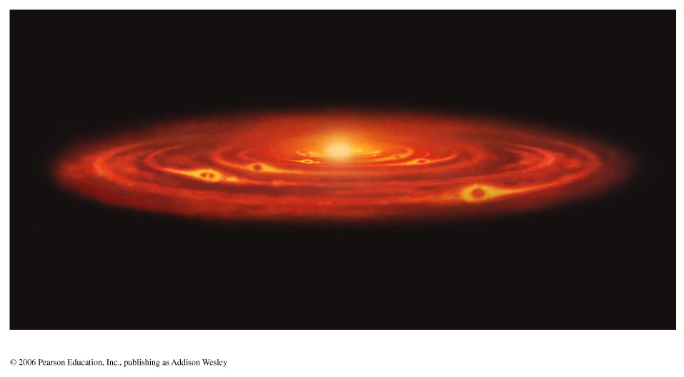
How did the solar system form?

Slide 4
Notes:
Pause the slide show and play the video, James Webb Space Telescope – Planetary Evolution.
Source: NASA, Portal to the Universe.
URL: http://www.portaltotheuniverse.org/podcasts/eps/view/82595/
Run time: 3:20 minutes

Slide 5

Astro Comics Presents…
Before Planets
A nebula is a cloud of dust and gas in space.
Long ago…
Nebula
Hmm…I am just moving around randomly.
Characteristics of Great Comics:
Keep it simple
One idea per panel
Organize your ideas
Beginning, Middle and End

Slide 6
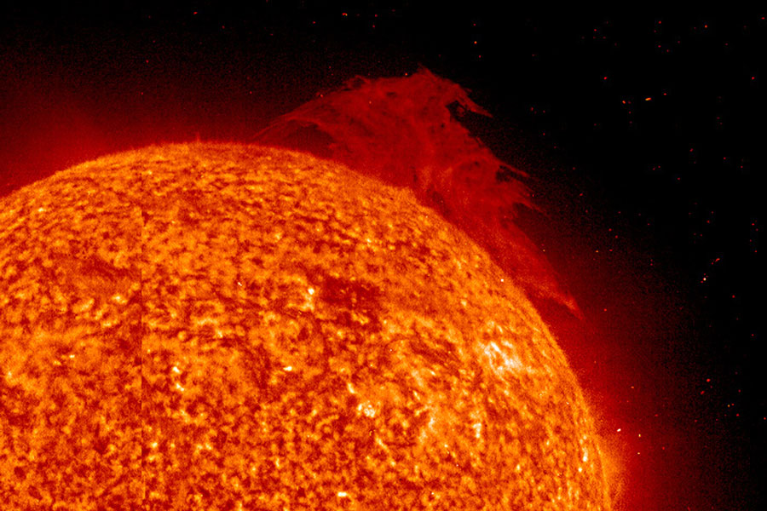
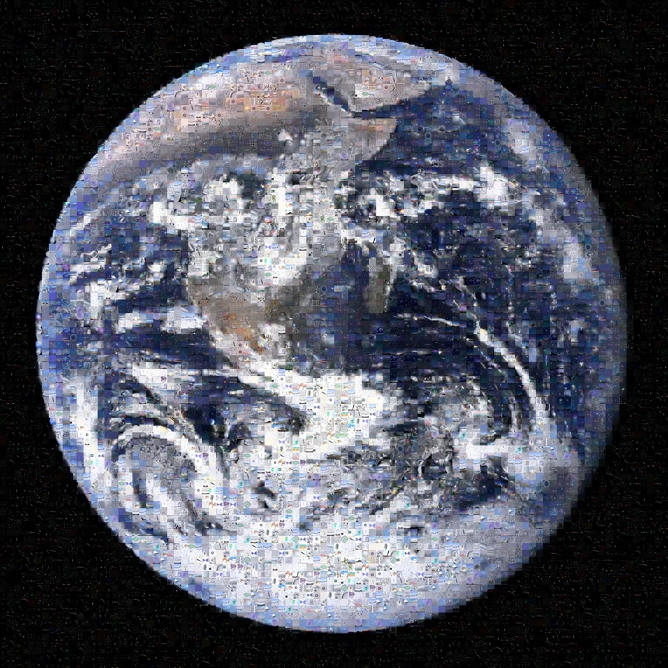
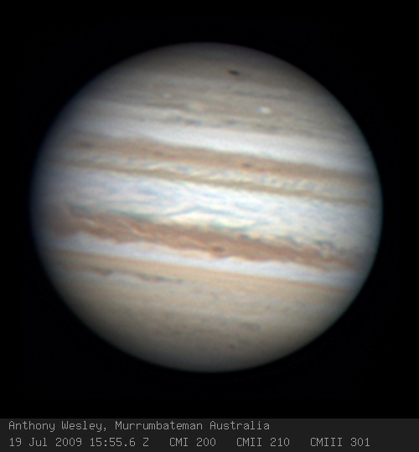
What is the composition of the Universe?
Notes:
NOTE: Images NOT to scale
All images from, Astronomy Picture of the Day webiste

Slide 8
Which elements do we find beyond Earth?
What’s out there?
Notes:
H = Hydrogen
He = Helium
C = Carbon
N = Nitrogen
O= Oxygen
Ne = Neon
Mg = Magnesium
Si =Silicon
S = Sulfur
Fe = Iron

Slide 9
The Astronomer’s Periodic Table
H
He
Most of the universe is composed of hydrogen!
C N O
Ne Mg Si S Fe
Notes:
H = Hydrogen
He = Helium
C = Carbon
N = Nitrogen
O= Oxygen
Ne = Neon
Mg = Magnesium
Si =Silicon
S = Sulfur
Fe = Iron

Slide 10
The Astronomer's Periodic Table

Slide 11
Most of the Universe is hydrogen.

Slide 12
Most of the universe is hydrogen

Slide 13
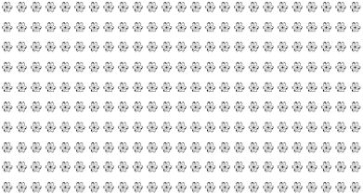
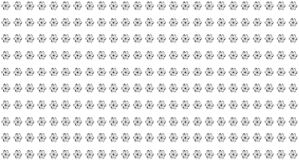
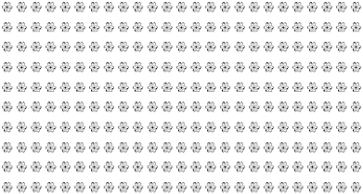

The universe contains 1,449 atoms of hydrogen for each atom of oxygen!
Hydrogen atoms
Oxygen atom
to

Slide 14
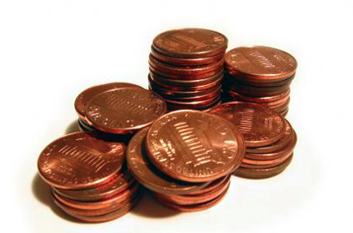
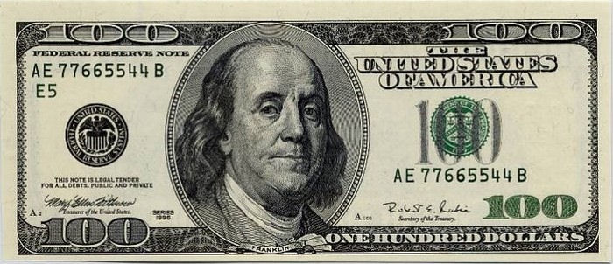
Comparing atoms of hydrogen to atoms of other elements is like comparing pennies to a $100 bill

Slide 15
Different Compositions
Universe
75% Hydrogen
23% Helium
1% Oxygen
1% Other
75% Hydrogen
24% Helium
0.03% Water
0.03 % Ammonia
0.03% Methane
0.01% Other
Jupiter
32% Iron
30% Oxygen
15% Silicon
14% Magnesium
3% Sulfur
2% Calcium
2% Nickel
1% Aluminum
1% Other
Earth
Notes:
To Notice
The composition of Jupiter more closely represents the composition of the Universe and stars. Juno’s principal goal is to understand the origin and evolution of Jupiter. Underneath its dense cloud cover, Jupiter safeguards secrets to the fundamental processes and conditions that governed our solar system during its formation. As our primary example of a giant planet, Jupiter can also provide critical knowledge for understanding the planetary systems being discovered around other stars.

Slide 16
Insert images of beads, bags, calculators, data tables

Slide 17
Additional Slides
Additional slides are provided for various uses:
To extend or enhance the slideshow
As additional reference material for the instructor or students
To address topics that might arise during class that are tangential to the focus of the lesson

Slide 18
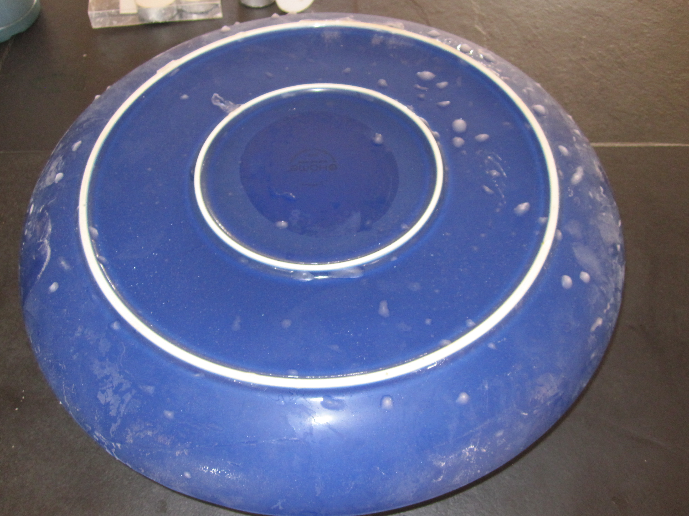
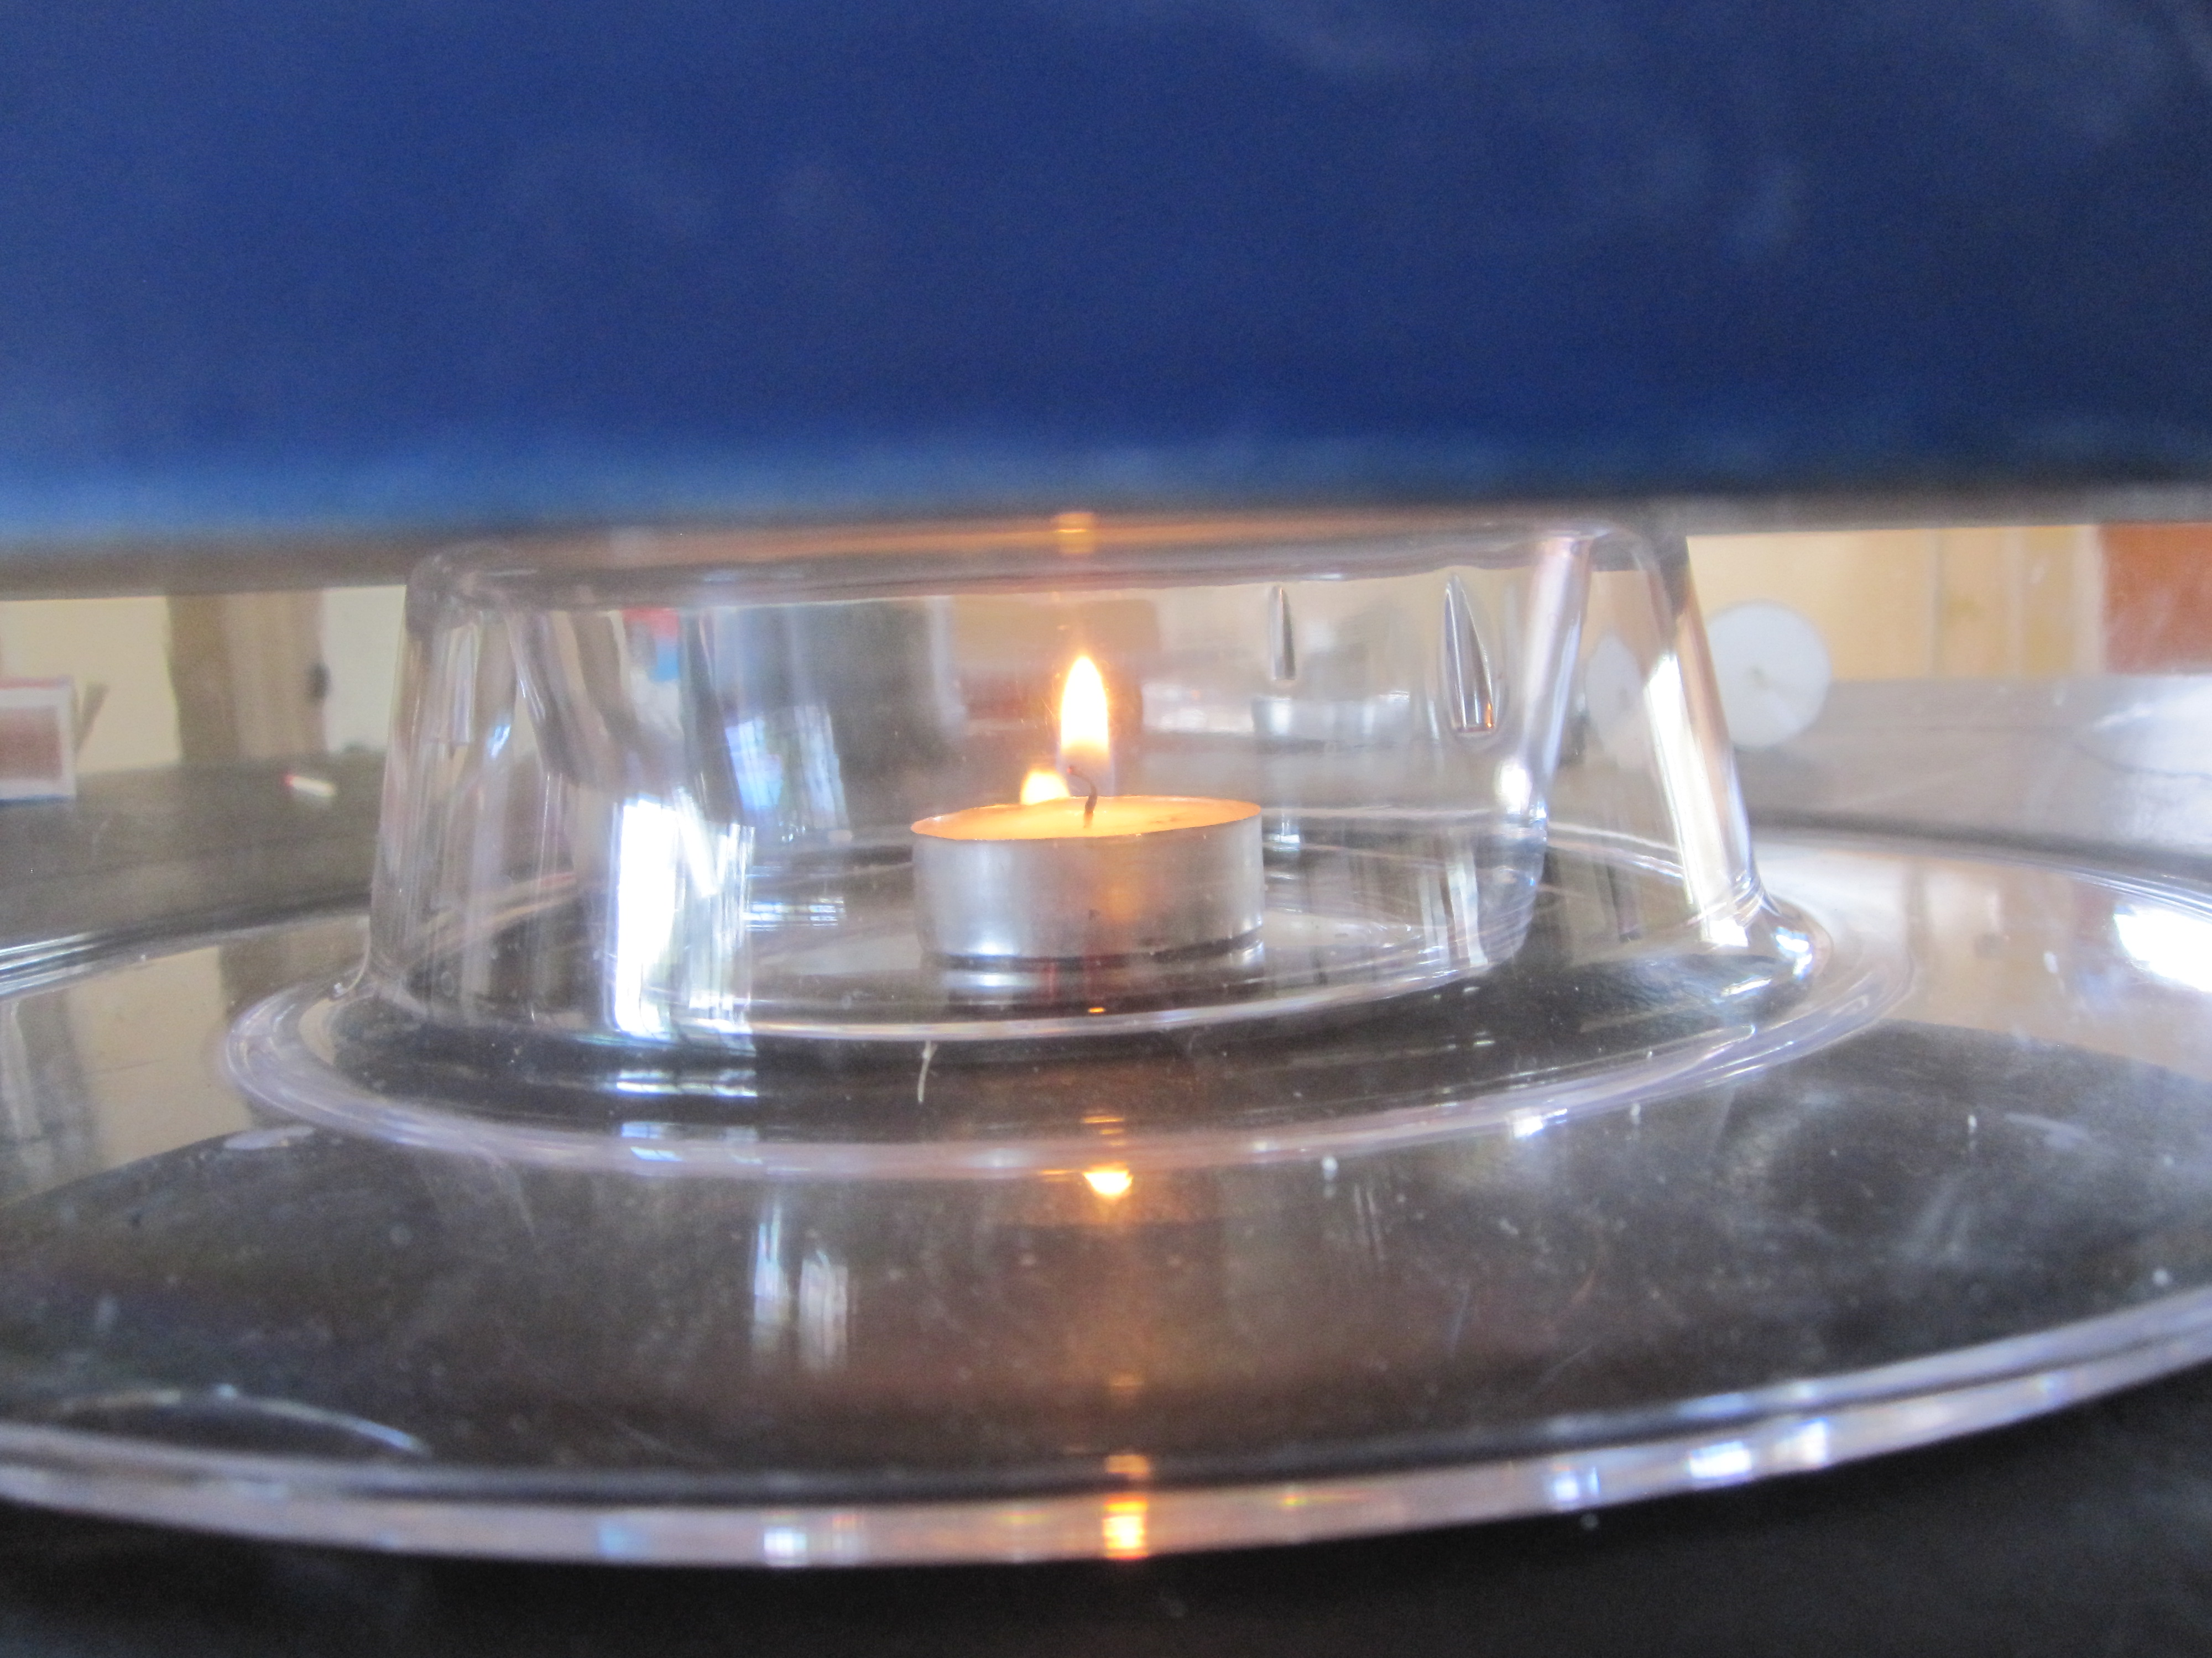
Demonstration Images - Making a Frost Line

