Slide 1
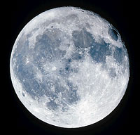
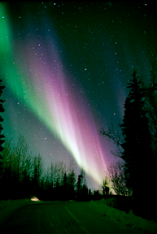
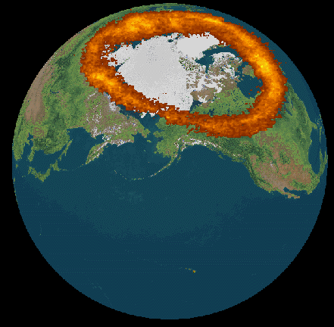
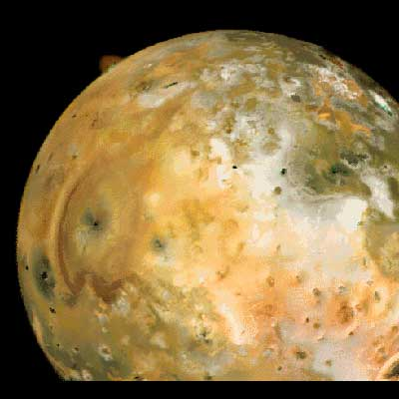
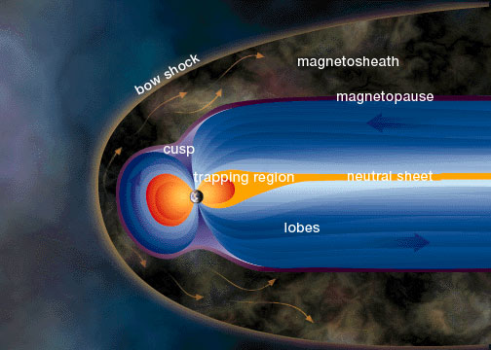
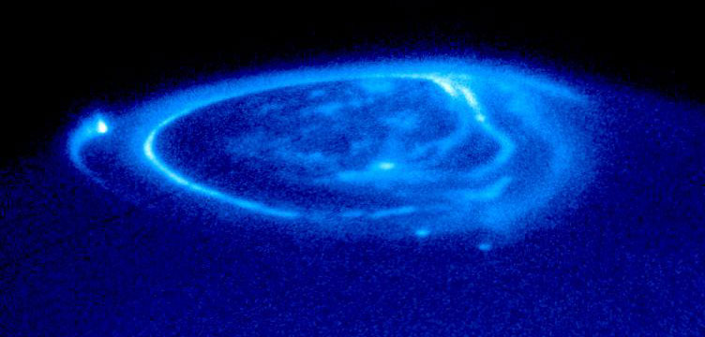
Aurora of Earth, Aurora of Jupiter: A Celestial Scavenger Hunt

Slide 2
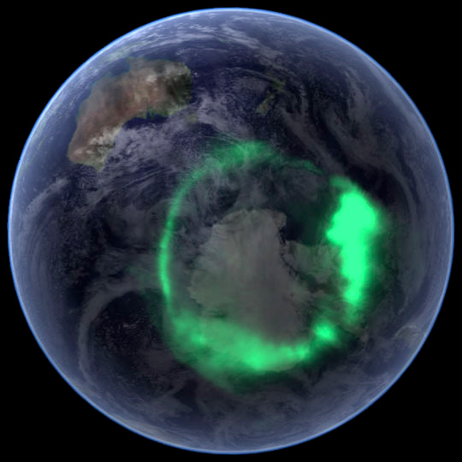
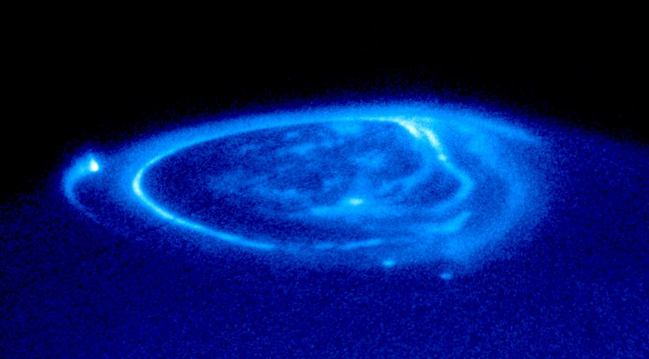
To the Student
What You Will Do and Learn
In this activity, you will use specific website pages and this presentation to compare and contrast the aurora of Earth to the aurora of Jupiter.
You will learn:
Where to observe aurora
What aurora look like and why
How to figure out which planets in our solar system have aurora
How the atmosphere, the magnetosphere, and energy combine to cause aurora
Differences and similarities between aurora of Earth and of Jupiter

Slide 3
To the Student
How to Use this Presentation
Use the PowerPoint and the Internet links to make observations about Earth and Jupiter. Not all resources agree, sometimes the details differ. That is okay. Scientists and experiments do not always agree!
Each topic is called a “station”. At each station there are questions to answer. Use the information at the station and the links to the Internet to answer the questions.
To keep track of what you learn, record your work on the table, Aurora of Earth, Aurora of Jupiter: A Celestial Scavenger Hunt
Questions are written in GREEN.
Record your answers on the table, Aurora of Earth, Aurora of Jupiter: A Celestial Scavenger Hunt

Slide 4
To the Student
What the Symbols Mean
On each page you will find text, images, and sometimes symbols. Each symbol is a link to an Internet resource.
Click each symbol to open the Internet source.
= Click the camera symbol to
watch a video. Special instructions come with some videos.
= Click the ear to listen to a recording. Special instructions come with some audio files.
= Click the globe to open a
website page. Two globes equals two different links.
= Click pictures to learn more about each image

Slide 5
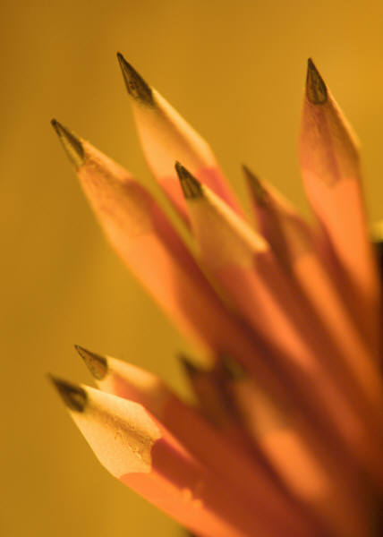
To the Student
The Equipment You Need
To complete the scavenger hunt you will need:
A computer with Internet access
Video and audio software such as Quicktime orRealPlayer
Pencil/pen
Hardcopy of the handout, Aurora of Earth, Aurora of Jupiter: A Celestial Scavenger Hunt

Slide 6
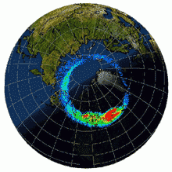
Station #1: Looking at Aurora
Where to See Aurora
Aurora form near the north and south poles of Earth. They look like glowing clouds and take many shapes.
People have several names for aurora. You may know some of these names: Northern Lights, Southern Lights, Aurora Borealis, and Aurora Australis.
To answer the question for this station, use the information on this page and links to the Internet.
Find a place on the globe where you could go to see auroras. Explain your choice of location.
What time of day is best to see auroras?
What time of year is best see auroras?
This image of Earth was made by combining several different images
This image of Earth shows the aurora in green.

Slide 7
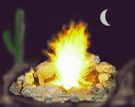
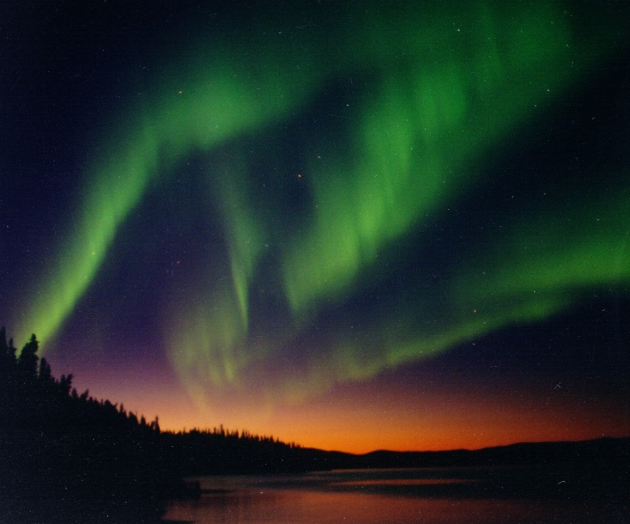
Station #1: Looking at Aurora
What Causes the Aurora Colors?
Light a match or sit around a fire and you may see different colors. The colors of a fire, like the colors of an aurora, depend upon the amount of energy and the type of material.
Aurora occur when electrons or protons trapped in Earth’s magnetic field move toward the poles. As they move, the particles gain energy. The moving particles crash into atoms of oxygen and nitrogen. These collisions produce energy that we see as light. The colors depend upon the amount of energy released during the crash. Also, the colors depend upon the type of atom hit. Oxygen and nitrogen create different colors when hit.

Slide 8
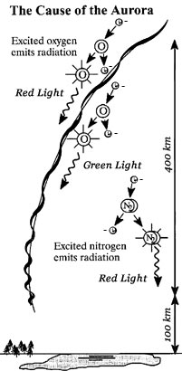
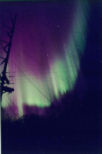
Station #1: Looking at Aurora
To answer the questions for this station, use the information in this presentation and links to the Internet.
What color auroras occur on Earth?
Oxygen and nitrogen produce different colors, pick one gas and find out which colors it contributes to the aurora.

Slide 9
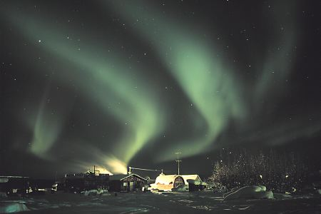
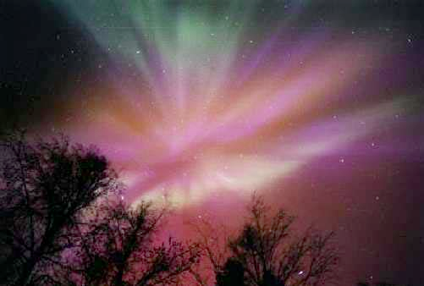
Station #2: More about Aurora
What Shapes Aurora?
Aurora come in several shapes and they may change shape as you watch. From space, the aurora form an oval around the magnetic north and south poles. To observers on the ground aurora may look like ribbons, curtains, or clouds.
Scientists are still trying to understand why aurora appear in different shapes.
To answer the questions for this station, use the information on this page and links to the Internet.
Describe at least two different shapes of aurora.
What are some possible explanations of the shapes of aurora?

Slide 10
Station #2: More about Aurora
Learn more about aurora by listening to this interview.
Special Instructions:
Open the Internet to the website: Sun-Earth Viewer
Select “Interviews” from the menu at the top.
Select “Aurora” from the list of subjects in box #2
Choose questions 5 and 6 from box 3.
After listening to the interview: Summarize the answers to questions 5 and 6 in your own words.

Slide 11
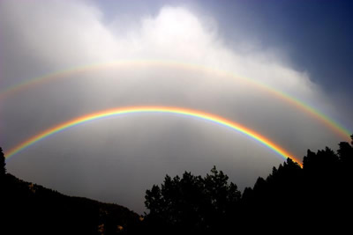
Station #3: Do Other Planets Make Aurora?
What does a Planet need to Make Aurora?
To create aurora around a planet, the following must exist:
Atmosphere
Magnetosphere
Source of Energy
We know aurora exist on Earth. Let’s review the necessary characteristics.
Atmosphere + Magnetosphere + Energy from the Sun = Aurora
The Earth’s atmosphere made mostly of the elements oxygen and nitrogen. The liquid metal core of Earth creates a magnetic field, or magnetosphere, around our planet. The Sun continually radiates energy toward Earth. The energy of the Sun forces charged particles in Earth’s magnetosphere to move toward the poles. These particles collide with atoms of oxygen and nitrogen, releasing energy that we see as aurora.

Slide 12
Station #3: Do Other Planets Make Aurora?
Do Other Planets Make Aurora?
To answer the questions for this station, use the table on this page and links to the Internet.
Which other planets in our solar system have the ingredients to make aurora?
Planet | Composition of Atmosphere | Magnetosphere | Energy Source
Mercury | Very little atmosphere | Yes | Sun
Venus | CO₂ | No | Sun
Earth | N₂ and O₂ | Yes | Sun
Mars | CO₂ | Maybe | Sun
Jupiter | H₂ and He | Yes | Internal heat
Saturn | H₂ and He | Yes | Internal heat
Neptune | H₂ and He | Yes | Internal heat
Uranus | H₂ and He | Yes | Internal heat

Slide 13
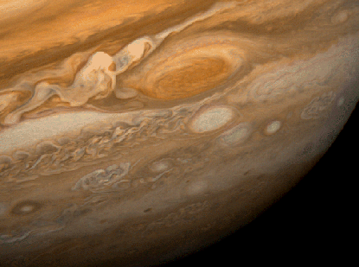
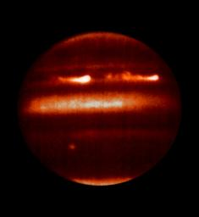
Station #3: Do Other Planets Make Aurora?
Does Jupiter Produce Aurora?
Yes, like Earth, Jupiter exhibits aurora.
Jupiter’s atmosphere is composed of the gases hydrogen and helium
Jupiter magnetosphere is the largest in the solar system
The energy source for creating aurora on Jupiter comes from the heat of the planet and its spin, not the Sun.
Planet | Composition of Atmosphere | Magnetosphere | Energy Source
Mars | CO₂ | Maybe | Sun
Jupiter | H₂ and He | Yes | Internal heat
Saturn | H₂ and He | Yes | Internal heat
Atmosphere + Magnetosphere + Internal heat = Aurora

Slide 14
Station #4: Comparing Planets
What Similarities and Differences of Earth and Jupiter are important to understanding Aurora?
Like Earth, Jupiter has all the characteristics required to create aurora. Plus, Jupiter has several features that make its aurora unique. Let’s compare Earth and Jupiter and explore some similarities and differences in detail.
Look at the table.
List at least three similarities or differences between Jupiter and Earth.
Characteristic | Jupiter | Earth
Atmosphere | Hydrogen and helium | Nitrogen and oxygen
Magnetosphere | Over 10 times stronger than Earth’s | Over 10 times smaller than Jupiter's
Energy source | Heat from the interior of the planet | Energy from the Sun
Role of Moons | Io supplies sulfur ions to the Jupiter’s magnetosphere; Moons travel within the magnetosphere | None
Colors | Pink and turquoise. Light from the Sun makes it difficult to see Jupiter’s aurora from Earth | Yellow, green, red, purple
Shape | Oval around poles; Appearance from below unknown | Oval around poles; Curtain, ribbons, clouds seen from below.
Other | Permanent aurora | Temporary aurora

Slide 15
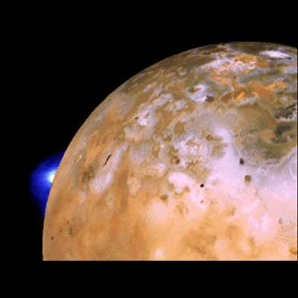
Station #4: Comparing Planets – Role of the Moons
Meet the Moon
The Moon has no atmosphere, but small amounts of some gases are present. The gases come from two sources, the solar wind and when meteoroids smash into the Moon. The solar wind is a continuous flow of gases from the Sun − mostly hydrogen and helium. On the Moon, it “rains” micrometeoroids. These meteoroids smash into the surface of the Moon melting and vaporizing moon rocks to make gases. The gases made by crushing moon rock are mostly sodium and potassium.
Introducing Io
Io, a moon of Jupiter, is volcanically active. The blue and white spot is an eruption of the volcano Loki. On Io, volcanoes continually erupt shooting sulfur into the atmosphere. Sulfur from Io enters the atmosphere of Jupiter. The charged sulfur particles help create aurora on Jupiter.
Describe two ways that the moons of Earth and Jupiter differ.

Slide 16
Station #4: Comparing Planets-Looking at Aurora from Space
Looking for Similarities and Differences
Look at each photograph.
Look at the aurora of Earth and Jupiter from space. Carefully describe two similarities and differences.
Notice the bright spots in the image of Jupiter. What might cause these spots?
Aurora on Earth seen from space
Aurora on Jupiter seen from space
Bright Spots

Slide 17
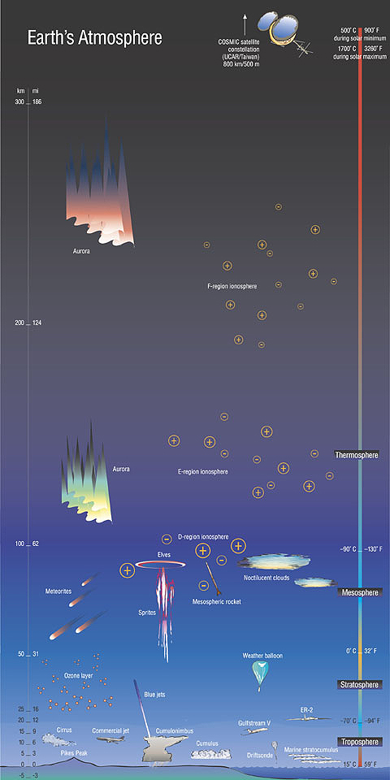
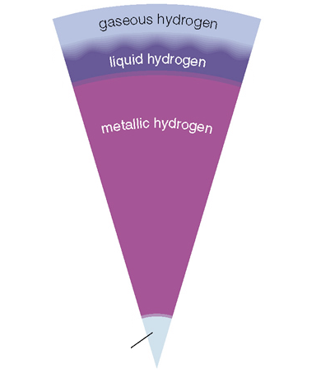
Station #5: Composition of the Atmospheres
How do the Atmospheres of Earth and Jupiter Compare?
Use these diagrams and Internet links to compare and contrast the atmosphere of Jupiter with the atmosphere of Earth.
List of some of the similarities and differences of the atmospheres of Earth and Jupiter.
Jupiter
Earth
Rock/Iron Core

Slide 18
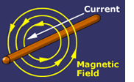
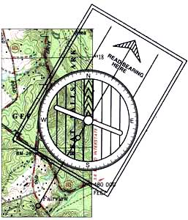
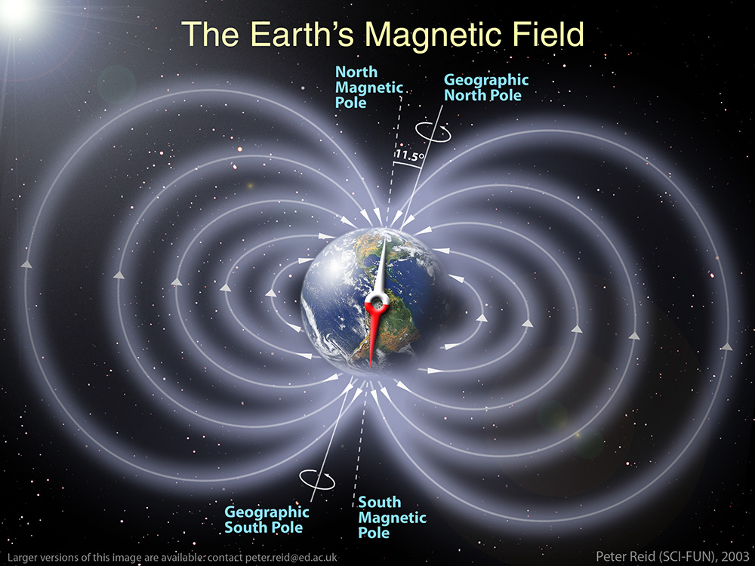
Station #6: Comparing Magnetospheres
What is a Magnetosphere?
A magnetosphere is the area, in space, around a planet dominated by the magnetic field. You probably know that a compass points toward the magnetic poles of Earth. The compass responds to the magnetic field produced by the core of Earth. Earth’s core contains liquid metal iron. As the Earth spins, the liquid also moves. The movement of the liquid iron creates an electric current. Electric currents produce magnetic fields.

Slide 19
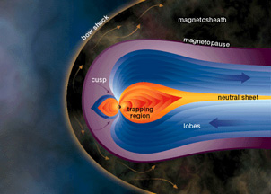
Station #6: Comparing Magnetospheres
How does Jupiter’s Magnetosphere compare to Earth’s Magnetosphere?
We cannot see the magnetospheres with our eyes. Scientists use special instruments to measure and map the magnetospheres around planets. The pictures on this page were drawn by artists to represent magnetospheres around planets. The magnetospheres of Earth and Jupiter look similar. Yet, the magnetospheres are also very different. One of the major differences is that Earth’s magnetosphere is a “dipole”. It has one north and one south pole. Jupiter’s magnetosphere is more complex. Scientists are still learning about it. At the moment, it is described as a quadrupole because it behaves like there are four poles.

Slide 20
Station #6: Comparing Magnetospheres
What are some other differences between Jupiter’s and Earth’s Magnetospheres?
Use the images and links to the Internet to answer the following questions:
What is the composition of the core of Jupiter?
How big is the magnetosphere of Jupiter?
How much bigger is Jupiter’s magnetosphere than Earth’s magnetosphere? (Hint: Use the picture to estimate the answer.)

Slide 21
Station #6: More about Magnetospheres
Learn more about magnetospheres by listening to the following interview.
10 Earths to fit across 1 Jupiter
Special Instructions:
Open the Internet to the website: Sun-Earth Viewer
Select “Interviews” from the menu at the top.
Select “The Magnetosphere” from the list of subjects
Select the questions shown in the box #3.
Listen to answers for the first 4 questions.
After listening to the interview:
Summarize the answers to questions 1-4 on your recording sheet.

Slide 22
Station #7: Adding the Energy
Where do Earth and Jupiter get the Energy to Create Aurora?
Recall our recipe for aurora. It requires ENERGY to create aurora. Aurora occur when electrons or protons trapped in the magnetosphere move toward the poles. As they move, the particles gain energy. The moving particles crash into atoms. These collisions produce energy that we see as light.
Aurora on Earth form when energy from the Sun causes particles in the Earth’s magnetosphere to move toward the poles.
Atmosphere + Magnetosphere + Energy = Aurora
Aurora on Jupiter form differently from aurora on Earth. It is complicated! Do your best to understand this topic.
There are two important sources of energy that contribute to creating aurora on Jupiter.
Jupiter spins really fast. The energy of the spin drags the magnetosphere around the planet.
Volcanoes on Io, a moon of Jupiter, erupt. They send lots of sulfur into the atmosphere of Io. As Io goes around Jupiter, the sulfur particles interact with the magnetosphere of Jupiter. The particles of sulfur have lots of energy that contributes to the formation of aurora on Jupiter.

Slide 23
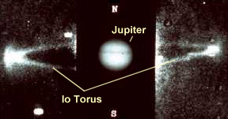
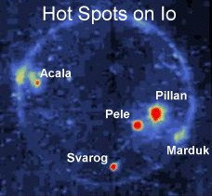
Station #7: Adding the Energy
How do Io and Jupiter Interact to Make Aurora?
The gases from volcanic eruptions on Io create a ring around Jupiter. The ring looks like a large doughnut. It is called a “torus”. The ring is made of plasma. Plasma contains electrically charged particles. The electrically charged particles of Io interact with the magnetosphere of Jupiter causing aurora to form.
#1
Look at the images on this page. Match the picture to the description and record this on your handout.
__shows a volcano erupting
__shows several volcanically active places on Io
__shows the plasma torus around Jupiter
#2
#3
In your own words, explain how Io contributes to aurora on Jupiter.

